Slide 1
Advanced Topics in Programming II
ASP.NET

Slide 2

Events in the Lifecycle of ASP.NET
Application level events
Page level events
Control level events

Slide 3
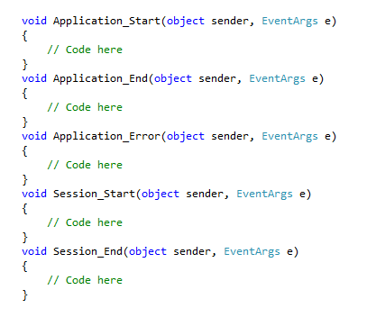
Application Level Events

Slide 4
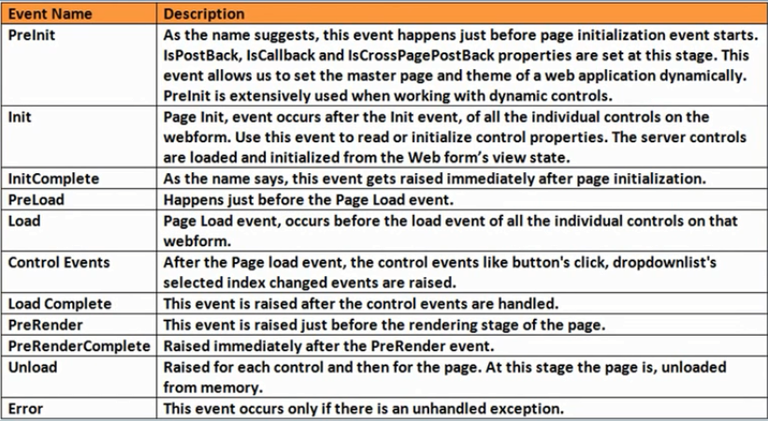
Page Level Events

Slide 5
Control Level Events
Button_Click event of a Button
Text_Changed event of a TextBox etc.

Slide 6
Classification of Control Level Events
PostBack event
Cached Event
Validation Event

Slide 7
ViewState in ASP.NET
Page level memory
Stores data across post back
Uses HTML hidden input field to store data in the page
Used by all ASP.NET controls to retain their state
Data is lost if a request for a another web form is generated

Slide 8
HTML controls vs ASP.NET controls
ASP.NET controls have asp namespace
ASP.NET controls can retain state, HTML controls cannot
HTML controls can be converted to retain state using id and runat attribute

Slide 9
Session State in ASP.NET
Variables are available across all the pages for a single session
Every user has his own session
Can be considerer as Single User Global Data
Stored in web server
Cleared when a session is timed out (default is 20 mins)
Timeout duration can be reconfigured in Web.config

Slide 10
Application State in ASP.NET
Variables are available across all the pages and all sessions
Can be considerer as Multi User Global Data
Stored in web server
Cleared when a the server process is restarted

Slide 11
TextBox Control
Properties
Text
TextMode
MaxLength
ReadOnly
ToolTip
Columns
Height
Width
AutoPostBack

Slide 12
TextBox Control
Events
TextChanged
Methods
Focus

Slide 13
RadioButton Control
Properties
Text
TextAlign
GroupName
AutoPostBack

Slide 14
RadioButton Control
Events
CheckedChanged

Slide 15
CheckBox Control
Properties
Checked
Text
TextAlign
AutoPostBack

Slide 16
CheckBox Control
Events
CheckedChanged
Methods
Focus

Slide 17
Hyperlink Control
Properties
Text
NavigateURL
ImageURL
Target

Slide 18
Hyperlink Control
Events
No event is specified for a Hyperlink control
Methods
Focus

Slide 19
Button Control
Properties
Text
Tooltip
PostBackURL
OnClientClick
UseSubmitBehavior
CommandName
CommandArgument
CausesValidation
ValidationGroup

Slide 20
Button Control
Events
Click
Command

